Slide 1



G. H. RAISONI COLLEGE OF ENGG. & MANAGEMENT Gat No. 1200, Wagholi, Pune – 412 207
(An Autonomous Institute Affiliated to Savitribai Phule Pune University)
Session 2020-21
Presentation on
“Xray”
By
Soham Yugraj Tiwari
Amaan Ayyub Nalband
Shravan Vijaypratap Singh
Pratik Rajesh Jade
(Roll no’s A69, A70, A71, A72)
Faculty Name: Ms Prajakta Kanase
FY B.Tech: Div A

Slide 2
X-rays

Slide 3
What are X-rays?
X rays are the ionizing electromagnetic radiation emitted from a highly evacuated high-voltage tube. Inner orbital electrons in the target anode are stimulated to emit x-radiation via bombardment by a stream of electrons from a heated cathode.
Most x-rays have a wavelength of 0.01-10 nanometeres, corresponding frequencies in the range of 30 petahertz(3X10¹⁶ Hz) to 30 exahertz(3*X10¹⁹Hz) and energies in the range of 100eV to 100 keV.
The images show the parts of your body in different shades of black and white. This is because different tissues absorb different amounts of radiation.

Slide 4
A little history about X-rays
As with many of mankind's monumental discoveries, X-ray technology was invented completely by accident. In 1895, a German physicist named Wilhelm Roentgen made the discovery while experimenting with electron beams in a gas discharge tube. Roentgen noticed that a fluorescent screen in his lab started to glow when the electron beam was turned on. This response in itself wasn't so surprising -- fluorescent material normally glows in reaction to electromagnetic radiation -- but Roentgen's tube was surrounded by heavy black cardboard. Roentgen assumed this would have blocked most of the radiation.

Slide 5
X-ray technology was discovered in 1895. Roentgen placed various objects between the tube and the screen, and the screen still glowed. Finally, he put his hand in front of the tube, and saw the silhouette of his bones projected onto the fluorescent screen. Immediately after discovering X-rays themselves, he had discovered their most beneficial application. Roentgen's remarkable discovery precipitated one of the most important medical advancements in human history. X-ray technology lets doctors see straight through human tissue to examine broken bones, cavities and swallowed objects with extraordinary ease. Modified X-ray procedures can be used to examine softer tissue, such as the lungs, blood vessels or the intestines.

Slide 6
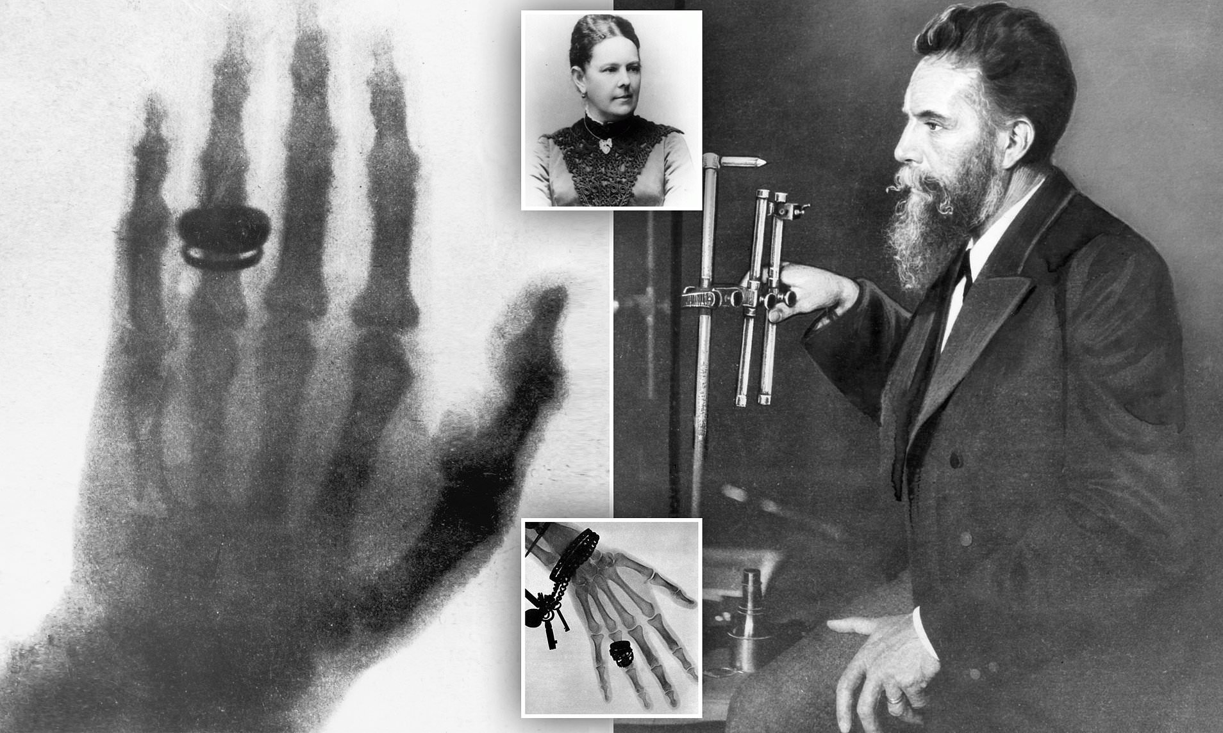
The first x-ray image obtained was of the hands of Wilhelm Roentgen's wife, taken on 22nd December,1895

Slide 7
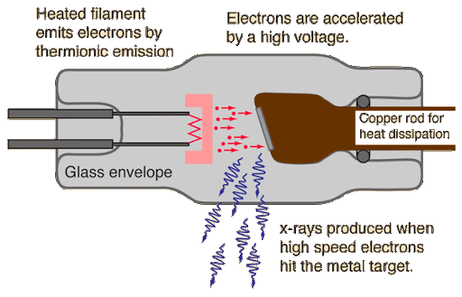
X-ray Tube
An x-ray tube requires a source of electrons, a means to accelerate the electrons, and a target to stop the high-speed electrons.

Slide 8
X-ray interactions
In passing through matter, energy is transferred from the incident x-ray photon to electrons and nuclei in the target material. An electron is ejected from the atom with the subsequent creation of an ion. There are three basic methods in which x-rays interact with matter: photoelectric effect, Compton scattering, and pair production. All these interactions are bad for living cells.

Slide 9
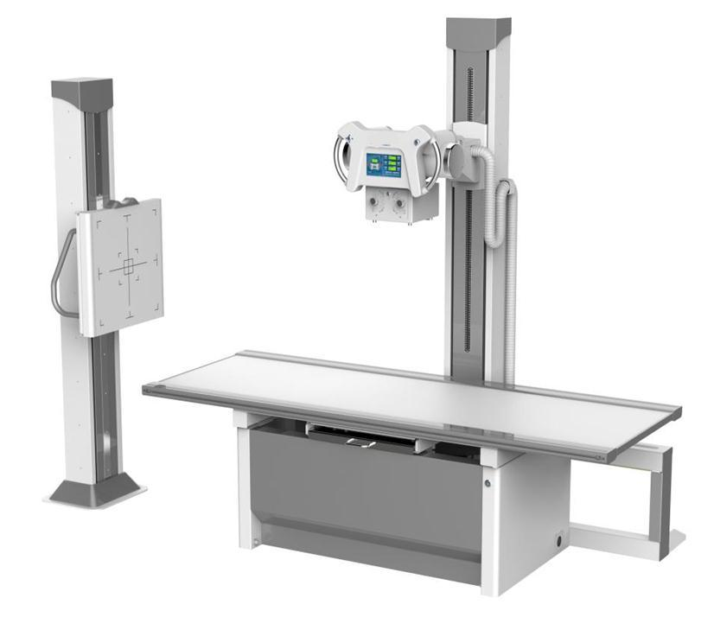
X-ray machine

Slide 10
COMPONENTS
X-ray generator :
X-rays are produced by an electron beam (emitted from heated cathode filament) that is accelerated to a high speed and strikes a target.
The electrons are then focused and accelerated by an electrical field towards an angled anode target.
The point where the electron beam strikes the target is called the focal spot.
Most of the kinetic energy contained in the electron beam is converted to heat, but around 1% of the energy is converted into X-ray photons.
Image detection system: a range of detectors have been used to collect images including:
Photographic film

Slide 11
Uses:-
Based on the energy of the radiations, x-rays have wide range of uses like in the medical field, industrial work places, security purposes etc.
Used in X-Ray scanners.
X-Ray crystallography.
Industrial radiography and CT scanning.
X-Rays has an immense role in the medical field – diagnostic as well as therapeutic.

Slide 12
Diagnostic Uses-
X-ray is the most preferred tool for detecting any bone related problem, such as fracture, tumor, degenerations. It is also used detect other cases like pulmonary tuberculosis, lung abscess, etc.
Therapeutic Uses-
It is used in cancer treatment to kill malignant cells.

Slide 13
X-rays are also used to:
Guide orthopedic surgery, such as spinal repair, joint replacement and fracture reductions.
Evaluate injury or damage from conditions such as infection, arthritis, abnormal bone growths or other bone diseases, such as osteoporosis.
Assist in the detection and diagnosis of cancer.
Locate foreign objects.
Evaluate changes in bones.

Slide 14
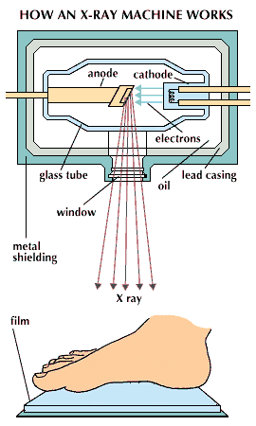
Purpose of X-Rays
Diagnostic x rays are useful in detecting abnormalities within the body. They are a painless, non-invasive way to help diagnose problems such as broken bones, tumors, dental decay, and the presence of foreign bodies.
Your doctor may order an X-ray to:
examine an area where you’re experiencing pain or discomfort
monitor the progression of a diagnosed disease, such as osteoporosis
check how well a prescribed treatment is working

Slide 15
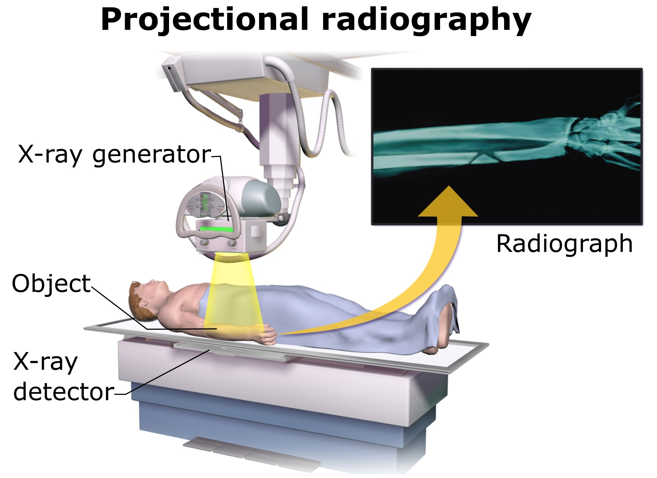
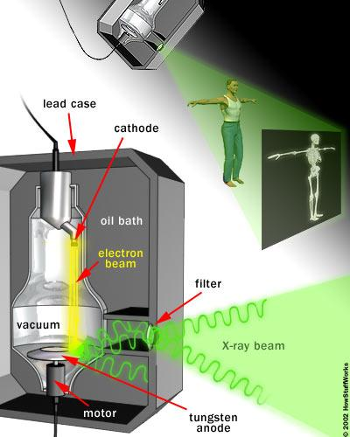
HOW AN X-RAY MACHINE WORKS

Slide 16
HOW DO X-RAYS WORK?
X rays pass easily through air and soft tissue of the body. When they encounter more dense material, such as a tumor, bone, or a metal fragment, they are stopped. Diagnostic x rays are performed by positioning the part of the body to be examined between a focused beam of x rays and a plate containing film. This process is painless. The greater the density of the material that the x rays pass through, the more rays are absorbed. Thus bone absorbs more x rays than muscle or fat, and tumors may absorb more x rays than surrounding tissue. The x rays that pass through the body strike the photographic plate and interact with silver molecules on the surface of the film.

Slide 17
Once the film plates have been processed, dense material such as bone shows up as white, while softer tissue shows up as shades of gray, and airspaces look black. a radiologist, who is a physician trained to interpret diagnostic x rays, examines the pictures and reports to the doctor who ordered the tests. plain film x rays normally take only a few minutes to perform and can be done in a hospital, radiological center, clinic, doctor's or dentist's office, or at bedside with a portable x-ray machine.

Slide 18
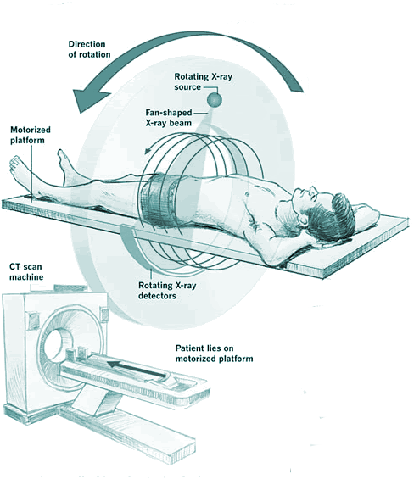
HOW AN X-RAY MACHINE WORKS
Special Type Of Xray: CT Scan

Slide 19
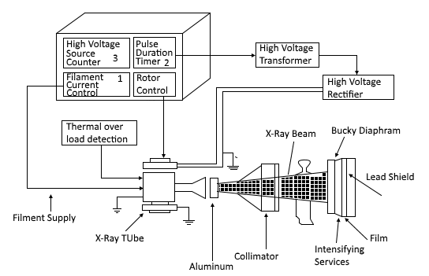
BLOCK DIAGRAM OF AN X-RAY MACHINE:

Slide 20
SPECIAL TYPES OF X-RAY PROCEDURES:
• Mammograms: are fixed plate x rays that are designed to locate tumors within the breasts. Dental x rays are designed to locate decay within the tooth.
• Fluoroscopy: is a special x-ray technique that produces real-time images on a television monitor. With fluoroscopy, contrast material is injected into a blood vessel. The physician can then watch the realtime movement of the contrast material to determine if there are blockages in circulation.

Slide 21
• Computed Tomography (CT-scan): scan works on the same principles as fixed plate x rays, with a CT scan, an x ray tube rotates around only d the individual, taking hundreds of images that are then compiled by a computer to produce a two-dimensional cross section of the body.
• Magnetic Resonance Imaging (MRI): uses a powerful magnetic field, radio frequency pulses and a computer to produce detailed pictures of organs, soft tissues, bone and virtually all other internal body structures.

Slide 22
Patient Preparation for X-ray:
Most bone x-rays require no special preparation.
Remove some or all of your clothes and wear a gown during the exam.
Remove jewelry, eye glasses and any metal objects or clothing that might interfere with the x-ray images.
Women should always inform their physician or x-ray technologist if there is any possibility that they are pregnant.

Slide 23

Precautions
Although unnecessary exposure to radiation should be avoided, the low levels of radiation one is exposed to during an x ray does not cause harm with a few exceptions. Pregnant women should not have x rays unless in emergencies the benefits highly outweigh the risks. Exposure of the fetus to x rays, especially during early pregnancy can increase the risk of the child later developing leukemia. Body parts not being x rayed should be shielded with a lead apron, especially the testes, ovaries, and thyroid.

Slide 24

Aftercare
Little aftercare is needed following an x ray. In complicated x rays where contrast material is injected into a blood vessel, the individual may need to remain under medical care for a short while to assure that there is no allergic reaction to the contrast material and recovery is complete.

Slide 25
Limitation of the conventional X-ray
Requires long time to expose the Patient with high dose.
Requires long time to Develop the film.
It’s hard to recycle the film.
Low in image quality.

Slide 26
Factors affecting Image Quality
• The x-ray beam is often described in terms of its quantity and its quality. The prime factors that affect x-ray quantity are milliamperage seconds (mAs), kilovoltage (kVp), source–image receptor distance (SID), and filtration. The factors that affect x-ray quality are kilovoltage and filtration.
• Note that kilovoltage and filtration affect both quantity and quality

Slide 27
Factors affecting Image Quality
Kilovolts (kVp)
• Controls radiographic contrast
• Controls x-ray penetration
• Controls the quantity and quality of the x-ray beam
• Increased kVp results in increased quantity of photons
• Increased kVp results in increased penetration of the body part
Milliamperes (mA)
• Controls radiographic density
• Controls quantity of x-rays produced
• Controlled by adjusting the filament heat
• Quantity of exposure is directly proportional to mA

Slide 28
Thank
You...

